Slide 1
Students’ Grade Monitoring System
SGM
W.D Rasika 0023

Slide 2
SYSTEM BRIEFLY
A Student Grade Monitoring system (SGM) can be used to track the progression of students
Advanced analysing graphs. This system is for school children from grade 6-11
Analysing students' progression, and analysing performance variation over the years in school are the main functionalities of this system
Allow to compare with friend’s marks
Upload CSV file(add new student and add markes)

Slide 3
SYSTEM REQUIREMENT
Functional Requirement
Authentication : To protect privacy of information
Displaying student information
Flexibility of user interface
Faster processing
View of previous data
Display statistical report of a student
Enable to compare with friends
Displaying analyzing graphical charts
Edit user profile
Sessions
Generating graphical reports

Slide 4
SYSTEM REQUIREMENT cont.
Non Functional Requirements
The software shall support use of multiple users at a time.
The website is made using HTML, CSS, JSP, PHP, etc. which are platform independent and can be transported to other servers with minimum effort.
The website should be user friendly and should require least effort to operate.
Easy to handle

Slide 5
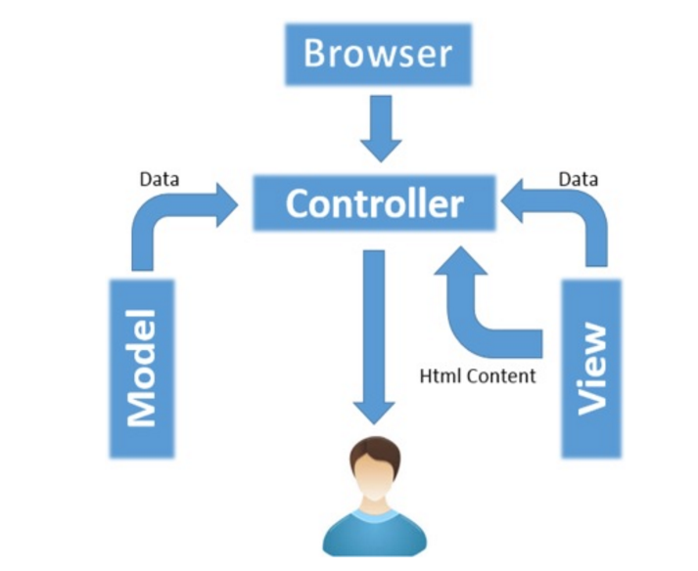
METHODOLOGY
Database handling (wampserver, mysql workbench)
MVC framework(CodeIgniter)

Slide 6
METHODOLOGY cont.
Bootstrap Templates
All graphs in this system are drawn using High Charts
In HighCharts JQuery and JavaScript is used
AJAX
CSV file upload
Student_index, subject_marks, term
Student_index, first_name, Last_name, Address, telephone

Slide 7
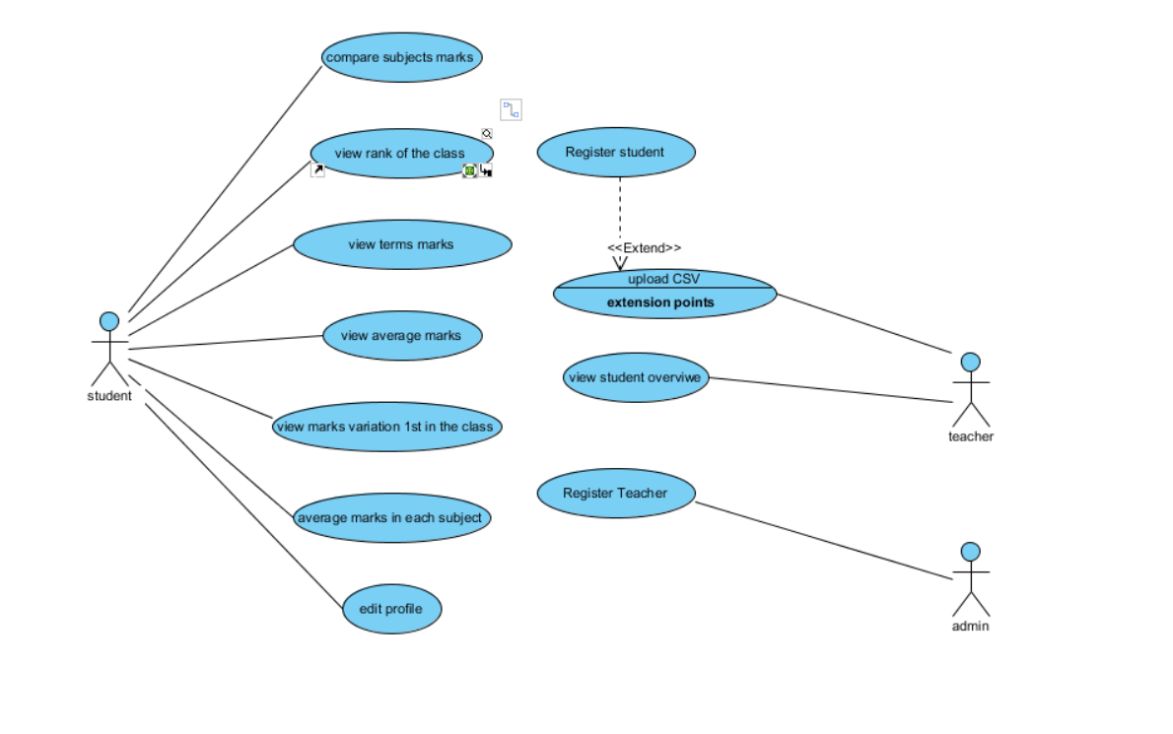
USE CASE DIAGRAM

Slide 8
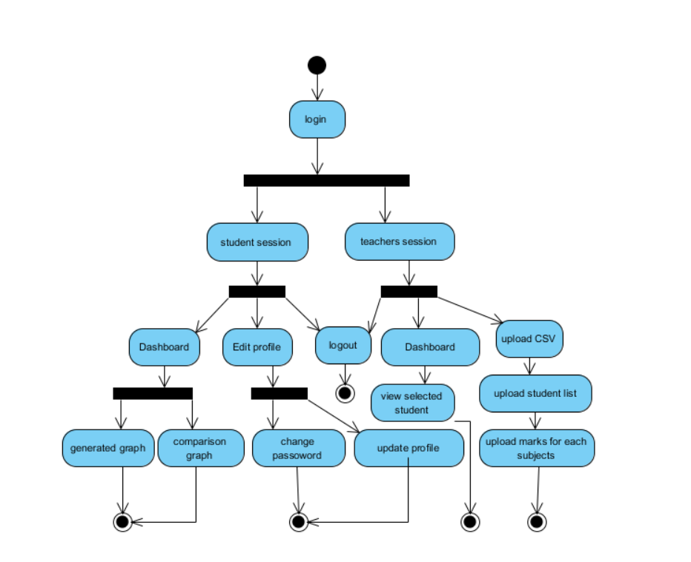
ACTIVITY DIAGRAM

Slide 9
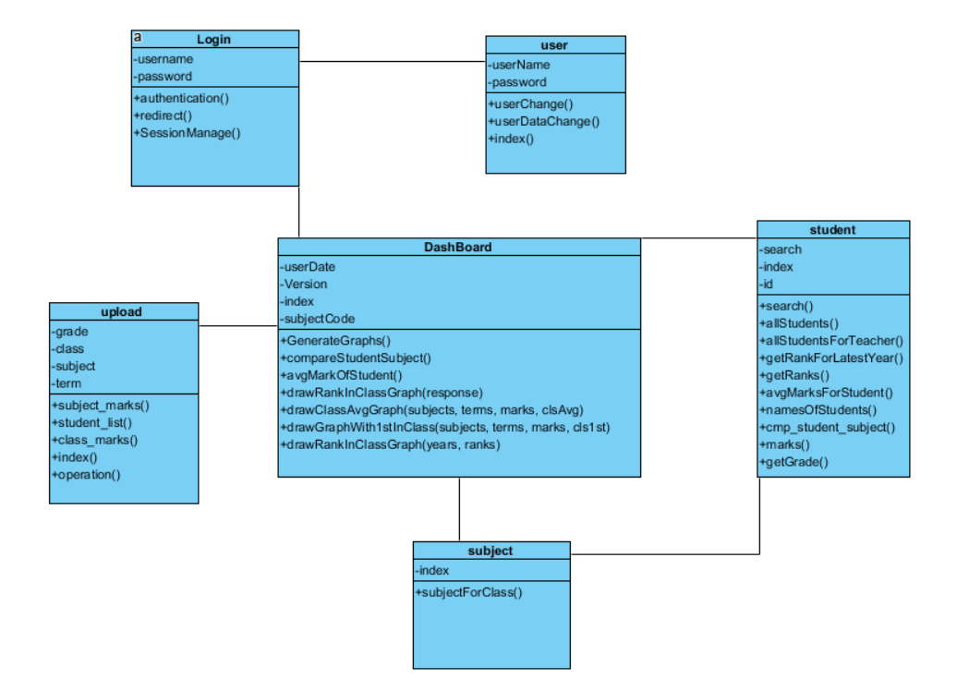
CLASS DIAGRAMS

Slide 10
THANK YOU

